Slide 1
CSE499A · FINAL PRESENTATION
CampusEye
Sophisticated Campus Monitoring System
An automated classroom attendance system using face recognition.
Rafiqul Islam · Safayat Ibrahim
Supervisor: Mohammad Shifat-E-Rabbi
CSE499A.15 · Dept. of Electrical & Computer Engineering
North South University · August 2026
CAMPUSEYE · CSE499A
01 / 15
Notes:
Introduce both members and the supervisor. State in one sentence what the semester produced: a working single-photo attendance system, grounded in a five-paper review, with the remaining scope planned for CSE499B. Roughly 45 seconds.

Slide 2
01 · INTRODUCTION
The problem with how attendance is taken
Universities still record attendance with a roll call or an RFID card. Both record a token — a spoken name or a tapped card — rather than confirming that a specific person is physically present.
Proxy attendance
Class time lost
Lost or shared cards
Entrance congestion
A classmate answers for an absent student, or taps their card. Neither method verifies the person.
Calling 30–100 names costs several minutes of every lecture, in every course, every week.
Cards are forgotten, lost or handed over. The card proves nothing about who is holding it.
Card readers form queues at doorways — precisely where a campus can least afford them.
The physical-verification gap. Every failure above shares one root cause. Closing it requires a system that checks a face, not a token — which is what computer vision makes practical.
CAMPUSEYE · CSE499A
02 / 15
Notes:
Land the closing sentence clearly — it is the justification for the entire project. Roughly one minute.

Slide 3
02 · OBJECTIVES & SCOPE
What CSE499A set out to achieve
OBJECTIVES
IN SCOPE — CSE499A
1
Mark a full classroom present from a single photograph, with no roll call.
Single-photo classroom attendance · student enrolment · course sections and rosters · automated absentee resolution · CSV export · per-account isolation · local deployment.
2
Verify physical presence, removing the proxy-attendance loophole.
3
Produce a complete register — present and absent — against a course roster.
Export institution-ready records for administrative use.
DEFERRED TO CSE499B
4
Live browser camera capture · continuous CCTV ingestion · multi-object tracking · anti-spoofing and proxy alerts · encryption of biometric data at rest · LMS integration · large-scale benchmarking.
5
Keep each teacher’s students and records private to their own account.
CAMPUSEYE · CSE499A
03 / 15
Notes:
The scope split is the most important slide for a 499A panel — it tells them what to judge this semester on. Be explicit that the right-hand column is planned and scheduled, not forgotten. About one minute.

Slide 4
03 · LITERATURE REVIEW
Five papers, and what each contributed
Paper | Method | What we adopted | Where we diverge
P1 · Budiman, 2023 | Systematic review: LBPH vs CNN | The evidence for a CNN backbone | A review, not a system; ours implements its conclusion
P2 · Abuazh, 2020 | LabVIEW pattern matching, Excel logs | Timestamped logging of every mark | SQLite as the store of record; no messaging subsystem
P3 · Chakraborty, 2020 | Haar Cascade + PCA/Eigenface | Per-student enrolment sets | CNN embedding replaces PCA; YuNet replaces Haar
P4 · Gomes, 2020 | Haar + LBPH, unknown-face store | Multi-face from one photo; unknown capture | Facenet embeddings replace LBPH
P5 · Oshin, 2025 | ArcFace 512-d, cosine @ 0.5, Redis | Embedding + cosine threshold matching | Facenet 128-d @ 0.6, SQLite, Flask
The review drove the design, not the other way round. P1 and P4 together justify choosing a CNN embedding over LBPH and Eigenface; P5 supplies the cosine-threshold matching strategy. Each borrowed decision was re-checked against our own source code.
CAMPUSEYE · CSE499A
04 / 15
Notes:
Give this slide the most time — around two minutes. P5 is the closest architectural relative; expect a question on why our threshold is 0.6 when P5 found 0.5 optimal. Answer: different embedding model, so the threshold is recalibrated rather than copied. Thresholds do not transfer between embedding spaces.

Slide 5
04 · RESEARCH GAP
What the reviewed systems do not do
Accuracy ceiling of classical methods
Three of the five reviewed systems rely on Haar with PCA or LBPH. P4’s own review reports roughly 95% for CNN approaches against 70–90% for Eigenface.
Addressed in 499A
Attendance recorded, absence inferred
Every reviewed system marks who was recognised. None computes who is missing against a course roster, so the register is never complete from one photograph.
Addressed in 499A
Records not queryable
Attendance is written to Excel sheets or text files. None of the reviewed systems provides a multi-user, queryable store with per-teacher isolation.
Addressed in 499A
No defence against spoofing
None of the five detects a photograph held to the camera, or the same identity appearing in two places. The proxy problem is named but not solved.
Planned for 499B
CAMPUSEYE · CSE499A
05 / 15
Notes:
The second gap is our strongest claim to originality — none of the five reviewed papers resolves absentees against a roster. Say that plainly; it is the difference between a recognition demo and an attendance system.

Slide 6
05 · METHODOLOGY
How the system was built and validated
Detection
Recognition
Matching
Enrolment
YuNet CNN detector (ONNX), with a Haar cascade retained as a compatibility fallback.
DeepFace with the Facenet model, producing a 128-dimensional embedding per face.
Cosine distance against every enrolled template; a match is accepted at or below 0.6.
Ten photographs per student, averaged into one template.
Chosen over Haar-only after P3 and P4 showed its sensitivity to pose and lighting.
Follows P1’s LBPH-vs-CNN conclusion and P4’s reported accuracy figures.
Adapted from P5, recalibrated for Facenet’s 128-d space rather than ArcFace’s 512-d.
Extends P5’s multi-sample capture, which does not combine the samples.
Validation. Development followed weekly milestones, each with a written acceptance criterion. Every module is covered by an automated test suite, and the final milestone was verified end to end through the HTTP API rather than in unit tests alone.
CAMPUSEYE · CSE499A
06 / 15
Notes:
The italic line in each column is the literature justification — that is what makes this methodology rather than a tool list. About 1.5 minutes.

Slide 7
06 · SYSTEM DESIGN
One pipeline, two uses
Enrolment and attendance are the same pipeline. They share detection and embedding, and diverge only in what happens to the resulting vector.
Enrolment · 10 photos
Attendance · 1 class photo
Detect faces · YuNet CNN
Embed · Facenet → 128-d vector
shared stages
Average → store template
Compare · cosine distance
Absent is then resolved as: course roster − recognised students.
≤ 0.6 Present
> 0.6 Unknown
CAMPUSEYE · CSE499A
07 / 15
Notes:
Because both paths share detection and embedding, improving either one improves enrolment and attendance together. Note the line at the bottom left — that is the roster-difference step, which is our addition and the reason the register is complete.

Slide 8
07 · IMPLEMENTATION
What was actually built
Detection & recognition
Enrolment workflow
YuNet detector, Facenet embeddings, cosine matching, unknown-face capture.
Ten-sample upload, per-sample validation, averaged template, stored per account.
Courses & rosters
Attendance & reports
Course sections, CSV roster import, roster management, absentee resolution.
Section-scoped scanning, live register, date navigation, sortable CSV export.
Accounts & isolation
Web interface
Login, per-account scoping of every student, register and embedding cache.
Server-rendered Flask pages plus a JSON API, rebuilt for accessibility compliance.
Python 3.10 · Flask · OpenCV / YuNet · DeepFace / Facenet · SQLite · pytest
CAMPUSEYE · CSE499A
08 / 15
Notes:
Keep this brisk — it is an inventory, not an explanation. The next slide shows it running, which is more persuasive than describing it. About 45 seconds.

Slide 9
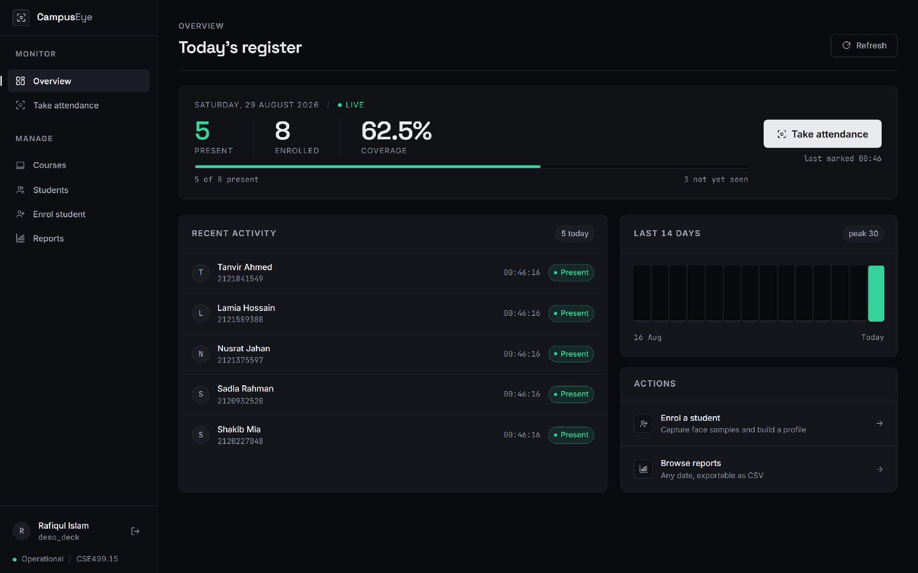
08 · IMPLEMENTATION
The system in operation
Overview — live register, roster coverage and a fourteen-day attendance trend.
CAMPUSEYE · CSE499A
09 / 15
Notes:
This is a screenshot of the running application, not a mock-up. If the room allows it, switch to a live demo here — the system runs locally and needs no internet. Otherwise these two screens carry it.

Slide 10
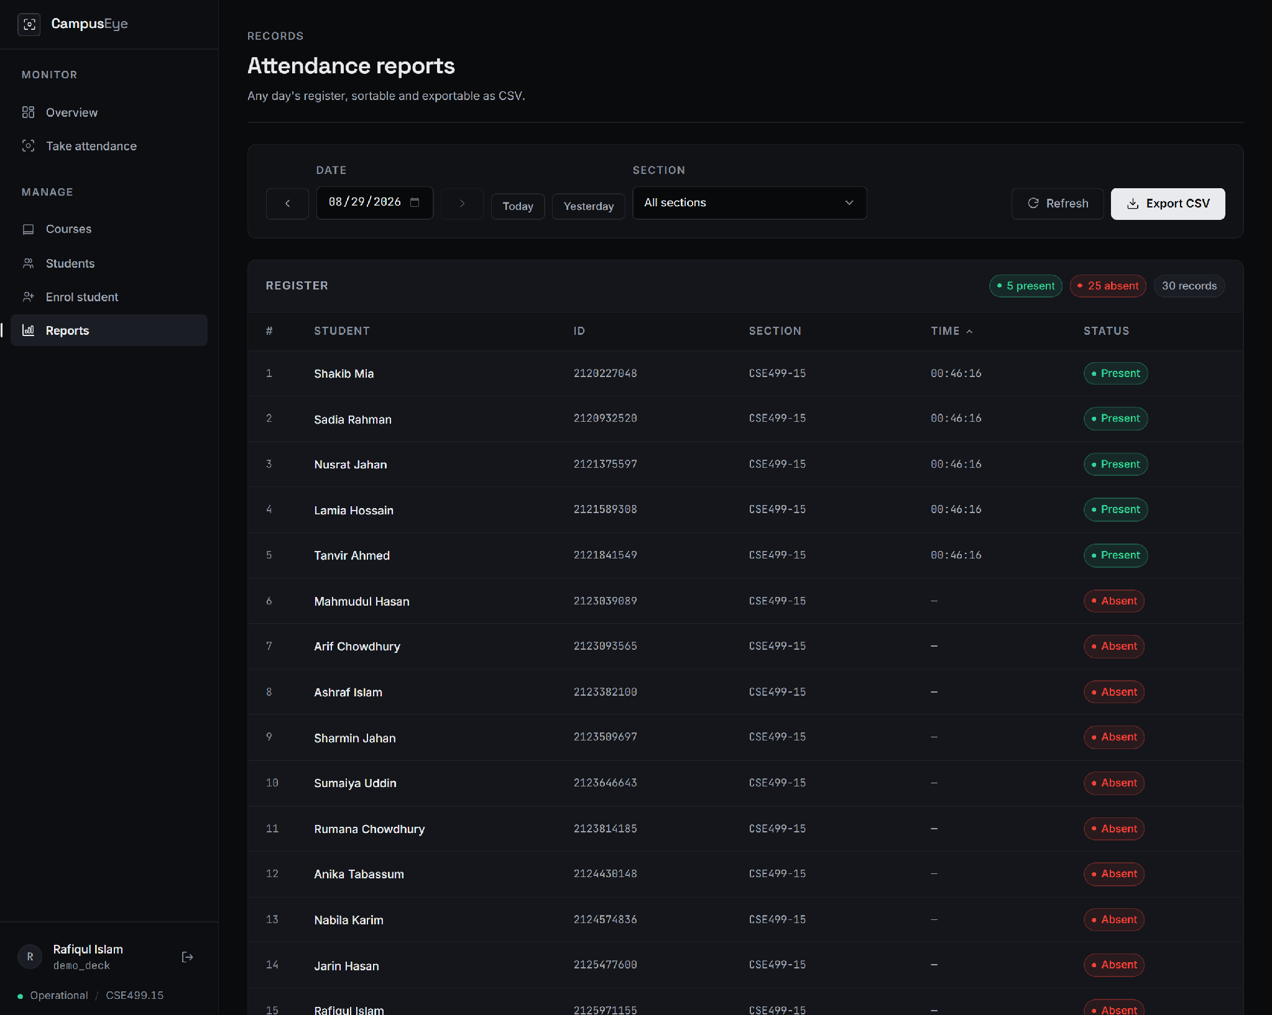
08 · IMPLEMENTATION
A complete register from one photograph
Attendance report — five students recognised, twenty-five resolved absent from the roster, exportable as CSV.
CAMPUSEYE · CSE499A
10 / 15
Notes:
Point out that every absent row carries a real name. Those students were never photographed — the names come from the imported course roster, which is exactly why the roster layer had to exist.

Slide 11
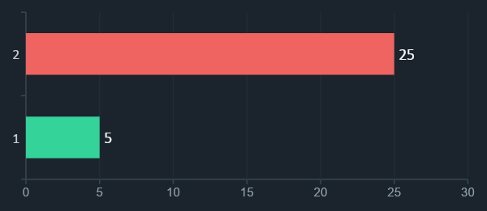
09 · RESULTS & TESTING
What can be demonstrated today
25
30
0
automated tests passing
students on the test roster
server errors in 853 requests
Acceptance test — one section, one photograph
Target: 5 present and 25 absent from a 30-student roster.
Five students were recognised from a single photograph. The remaining twenty-five were resolved against the course roster and written to the register as Absent — a complete register, with no manual entry.
Verified end to end through the HTTP API, not in unit tests alone.
CAMPUSEYE · CSE499A
11 / 15
Notes:
Be precise about coverage: the 25 tests cover account isolation, roster and absentee logic, and the schema migration. They do not measure recognition accuracy — that benchmark is CSE499B work. Saying so before you are asked is better than being caught by it.

Slide 12
10 · LIMITATIONS
Known limitations and issues
We audited the full codebase before this presentation: eighteen findings, six areas verified sound. The limitations that matter to this semester’s result:
Accuracy not yet measured
No benchmark on a large, labelled classroom dataset. The 0.6 threshold is adopted from the literature, not yet tuned on our own data.
CSE499B
Uploaded photographs only
Attendance requires a photograph to be uploaded. Live camera capture and CCTV ingestion are not implemented.
CSE499B
RFID hybrid not implemented
The original proposal described an RFID and face hybrid. The delivered system is face-only; RFID remains a design proposal.
Scope change
Test isolation defect
Two test files wrote into the live database. Found by our own audit; the fix is a temporary-database fixture, as our other tests already use.
Fix identified
Finding these ourselves, before they were found for us, is part of the engineering result.
CAMPUSEYE · CSE499A
12 / 15
Notes:
Present this as maturity, not apology. Stating the accuracy limitation yourself removes the single most likely hostile question. Every item here has a named owner in the next semester or an identified fix.

Slide 13
11 · CONCLUSION
What CSE499A delivered
A working system, not a prototype script
A design grounded in the literature
Enrolment, section-scoped attendance, complete registers and CSV export all run today, end to end, on a local deployment.
Five papers reviewed and mapped decision by decision; every borrowed choice traced and every divergence justified against our own source.
A gap identified and closed
Quality measured honestly
None of the reviewed systems resolves absentees against a course roster. Ours does, producing a complete register from a single photograph.
A full audit of our own codebase: eighteen findings with fixes identified, and six areas independently verified sound.
CAMPUSEYE · CSE499A
13 / 15
Notes:
Close on the third and fourth points. Grounded in literature and honestly measured are what separate a capstone from a demo. About one minute.

Slide 14
12 · FUTURE WORK
CSE499B — the implementation plan
The remaining scope is planned as eight versioned milestones, each with its own acceptance criterion, ending in the capstone defence.
W1
W2
W3
W4
W5
W6
W7
W8
Course & roster layer
Live camera & dual-threshold review
CCTV stream ingestion
Multi-object tracking
Anti-proxy & security alerts
AES-256 biometric encryption
LMS integration & analytics
Benchmarking & thesis defence
DONE IN 499A
Weeks 3 and 4 carry the highest technical risk. Continuous stream ingestion and multi-object tracking are substantially harder than single-photo matching, and are what turn this from a per-class tool into genuine campus monitoring.
Week 1 was completed during CSE499A and is demonstrated in this presentation.
CAMPUSEYE · CSE499A
14 / 15
Notes:
Say clearly that Week 1 is already done, so 499B starts from Week 2 rather than from zero. Flag Weeks 3 and 4 as the risk concentration — a panel respects a team that knows where its plan is hardest.

Slide 15
13 · REFERENCES
Literature and tools
[P1]
A. Budiman et al., "Student attendance with face recognition (LBPH or CNN): Systematic literature review," Bina Nusantara University, 2023.
[P2]
R. Abuazh et al., "Face Detection and Recognition Student Attendance System," College of Engineering, 2020.
[P3]
P. Chakraborty, "Automatic Student Attendance System using Face Recognition," Comilla University, 2020.
[P4]
C. Gomes et al., "Class Attendance Management System using Facial Recognition," 2020.
[P5]
O. Oshin et al., "Class Attendance System Using Facial Recognition," Covenant University, 2025.
TOOLS & LIBRARIES
DeepFace (Facenet model) · OpenCV YuNet face detector · Flask · SQLite · NumPy / SciPy · pytest
Rafiqul Islam · Safayat Ibrahim Questions welcome
CAMPUSEYE · CSE499A
15 / 15
Notes:
Leave this on screen during questions — the panel can see the citations while asking about them. Full PDFs are in the repository under Literature Review Paper/.

